Slide 1
BCDS Data Lifecycle
Data Acquisition
Claims Data
Ingested Models
Temporal Data
Data Processing & Mgt
(Model Repository)
Data Delivery
(Reporting)
Rating Determination Engine
Model
Mgt & Data Integration
Component | Component Description | Component Technology
Data Acquisition | A logical data repository responsible to staging of data and preparation of data and predictive models before processing | HDFS Oracle XML Files Scripts
Data Processing & Mgt | A logical data repository responsible for persisting Ear & Knee predictive models and the associated data for operation of BCDS Application | Oracle MongoDB
Data Delivery | A logical data repository responsible for persisting the results of a ratings determination for reporting purpose | Oracle

Slide 2
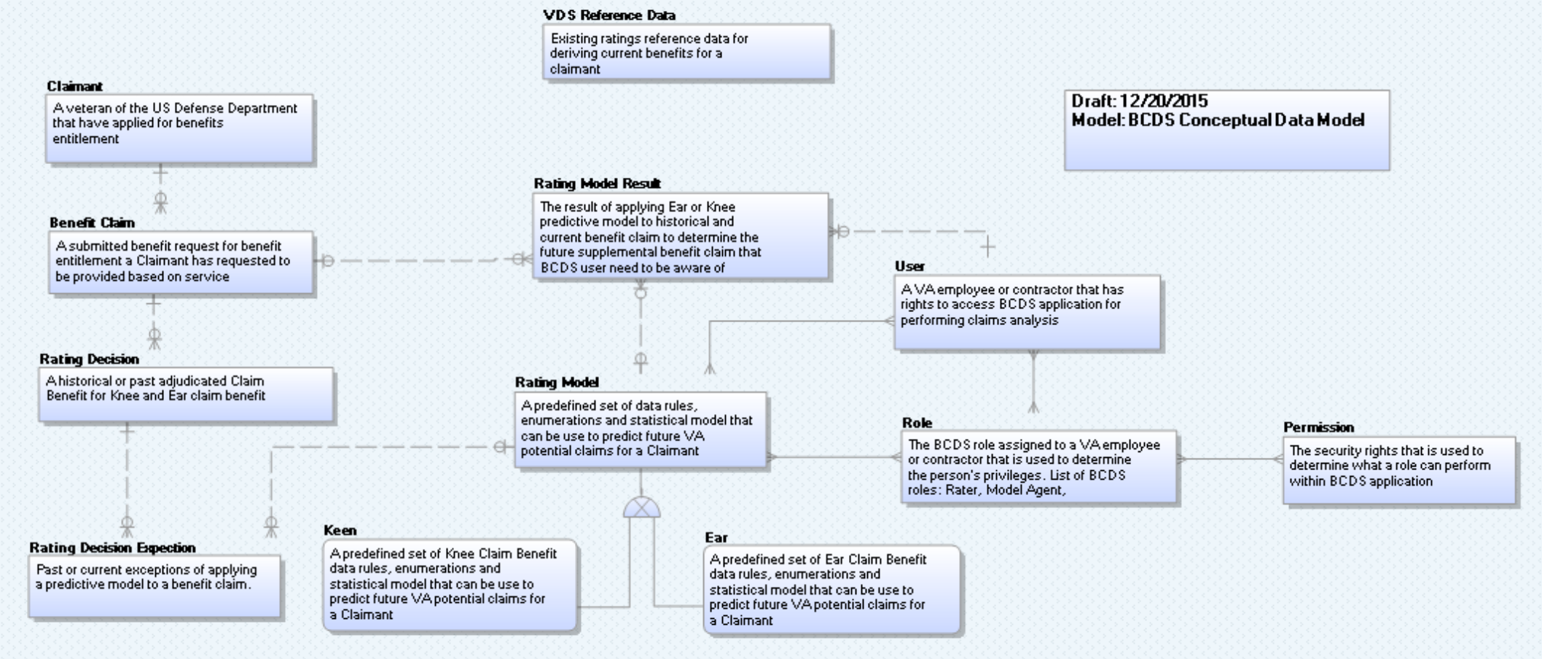
BCDS Conceptual Data Model

Slide 3
BCDS Conceptual Data Model
Entity Name | Object Type | Definition
User | Entity | A VA employee or contractor that has rights to access BCDS application for performing claims analysis
Rating Decision | Entity | A historical or past adjudicated Claim Benefit for Knee and Ear claim benefit
Ear | Entity | A predefined set of Ear Claim Benefit data rules, enumerations and statistical model that can be use to predict future VA potential claims for a Claimant
Keen | Entity | A predefined set of Knee Claim Benefit data rules, enumerations and statistical model that can be use to predict future VA potential claims for a Claimant
Rating Model | Entity | A predefined set of data rules, enumerations and statistical model that can be use to predict future VA potential claims for a Claimant
Benefit Claim | Entity | A submitted benefit request for benefit entitlement a Claimant has requested to be provided based on service
Claimant | Entity | A veteran of the US Defense Department that have applied for benefits entitlement
Rating Decision Expection | Entity | Past or current exceptions of applying a predictive model to a benefit claim.
Role | Entity | The BCDS role assigned to a VA employee or contractor that is used to determine the person's privileges. List of BCDS roles: Rater, Model Agent, Administrator, Modeling Analyst
Rating Model Result | Entity | The result of applying Ear or Knee predictive model to historical and current benefit claim to determine the future supplemental benefit claim that BCDS user need to be aware of
Permission | Entity | The security rights that is used to determine what a role can perform within BCDS application

